Slide 1
Nexam Chemical
Q1 2025 Presentation
25-04-24 | Ronnie Törnqvist, CEO
Marcus Nyberg, CFO
Notes:
Hello and welcome to this presentation of the second quarter for Nexam Chemical. My name is Ronnie Törnqvist, I'm the CEO of Nexam Chemical since a little over a year, and with me I have our CFO, Marcus Nyberg.

Slide 2
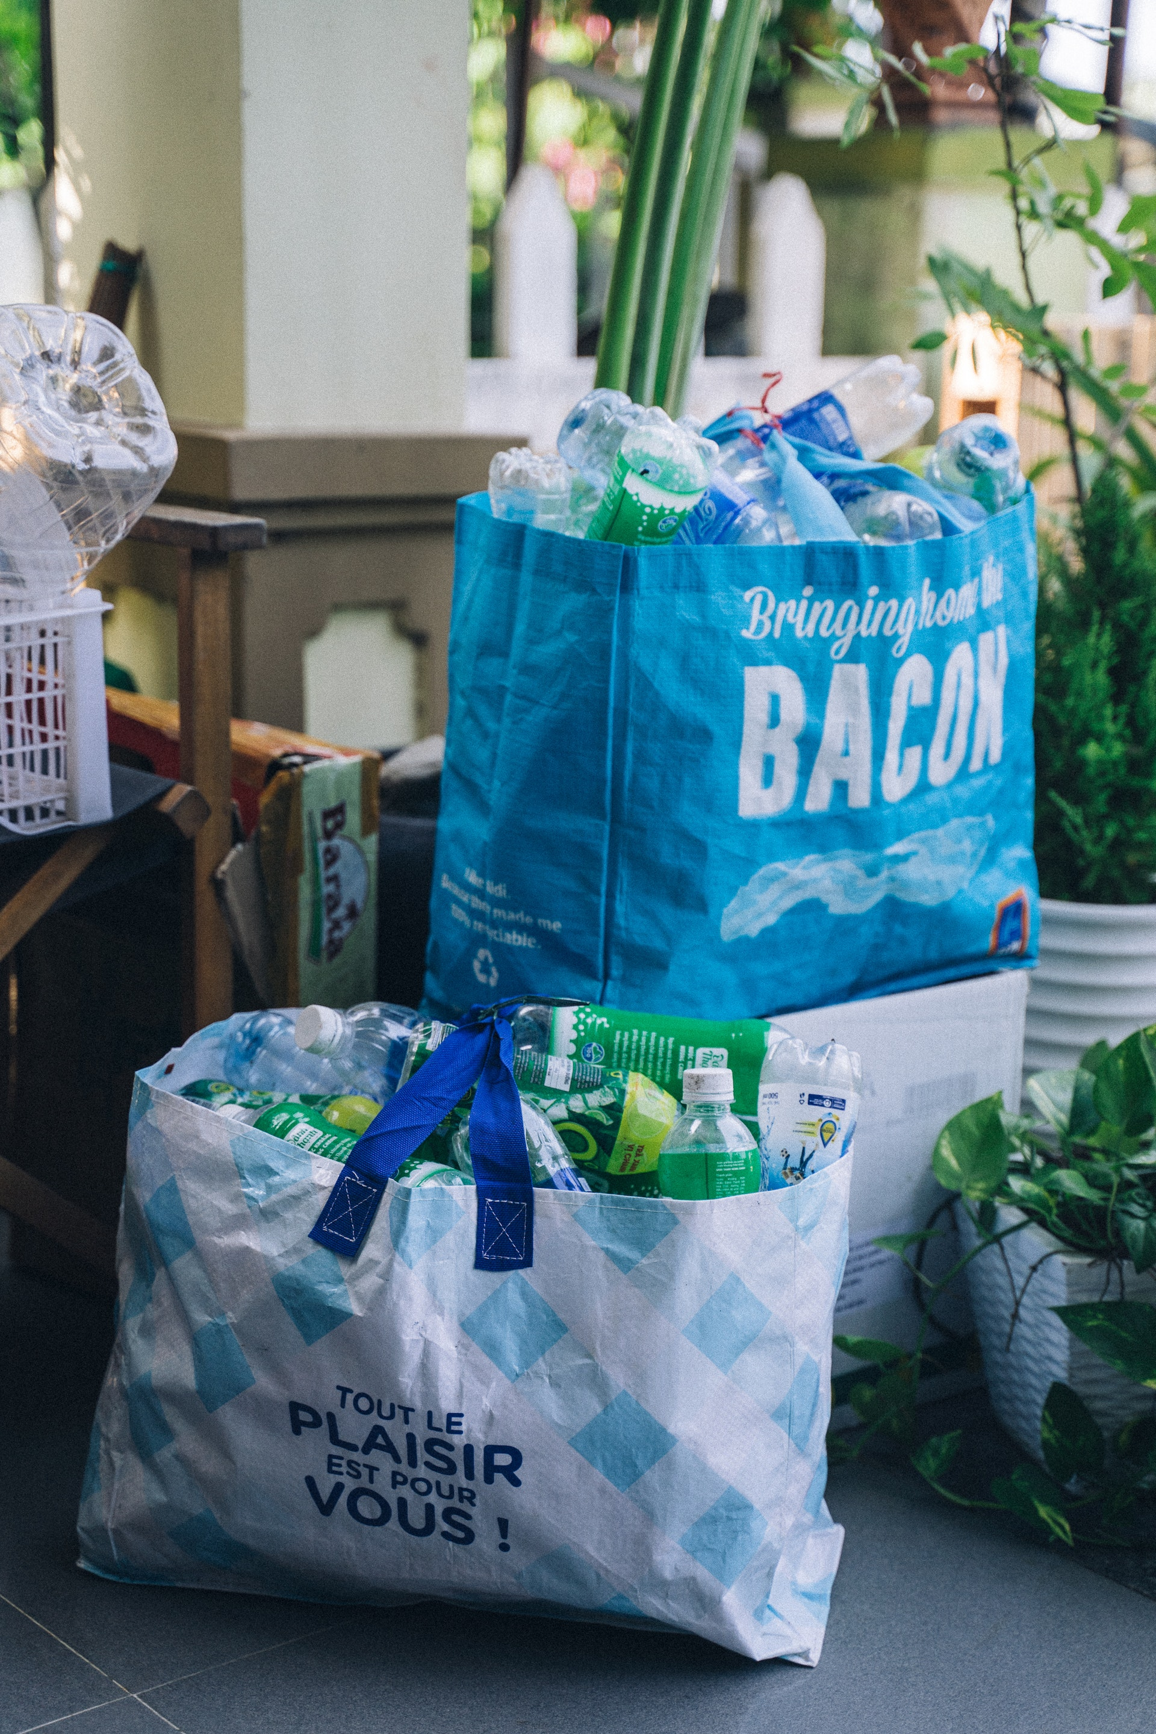
The future of plastics. Patented.
Notes:
I hope I have been able to give you a glimpse of our world. A world where we see what the future of plastics can look like. A future that we hold a lot of the keys to. Keys in the form of patents.
Q4 really saw the wind turning, and we have a positive outlook for 2024 combined with endless possbilities to grow our business on long term.
With that, I would like to open up for a Q&A session.
P/C: https://www.pexels.com/photo/white-wind-turbines-on-gray-sand-near-body-of-water-3976320/

Slide 3
Q1 2025 Sales of Reactive Recycling increased 50% vs. Q4 2024!*
*) More on this later on in the presentation

Slide 4
The future of plastics. Patented.
Innovative additives to modify polymers for new challenges
Light weighting and miniaturization
Renewable energy
Waste and recycling
Plastics for the future
Driven by global megatrends
Notes:
Nexam Chemical is a Swedish cleantech company with global reach, big ambitions, big plans, and the potential to reshape the future of plastics through our innovative chemistry.
Nexam's range of additives are based on the same basic ideas of applying reactive chemistry to modify various types of polymers, and it ends up in a very wide range of uses.
Our additives are used for applications like lightweighting and miniaturization in for example the vehicle industry and electronics, we also contribute in advanced applications like more efficient jet engines and even smaller microelectronics. Our two big adressable markets are renewable energy and waste and recycling. The two latter are truly driven by huge global megatrends, where our growth potential is massive – almost endless. - Thanks to the innovative additives that can improve plastic materials.

Slide 5
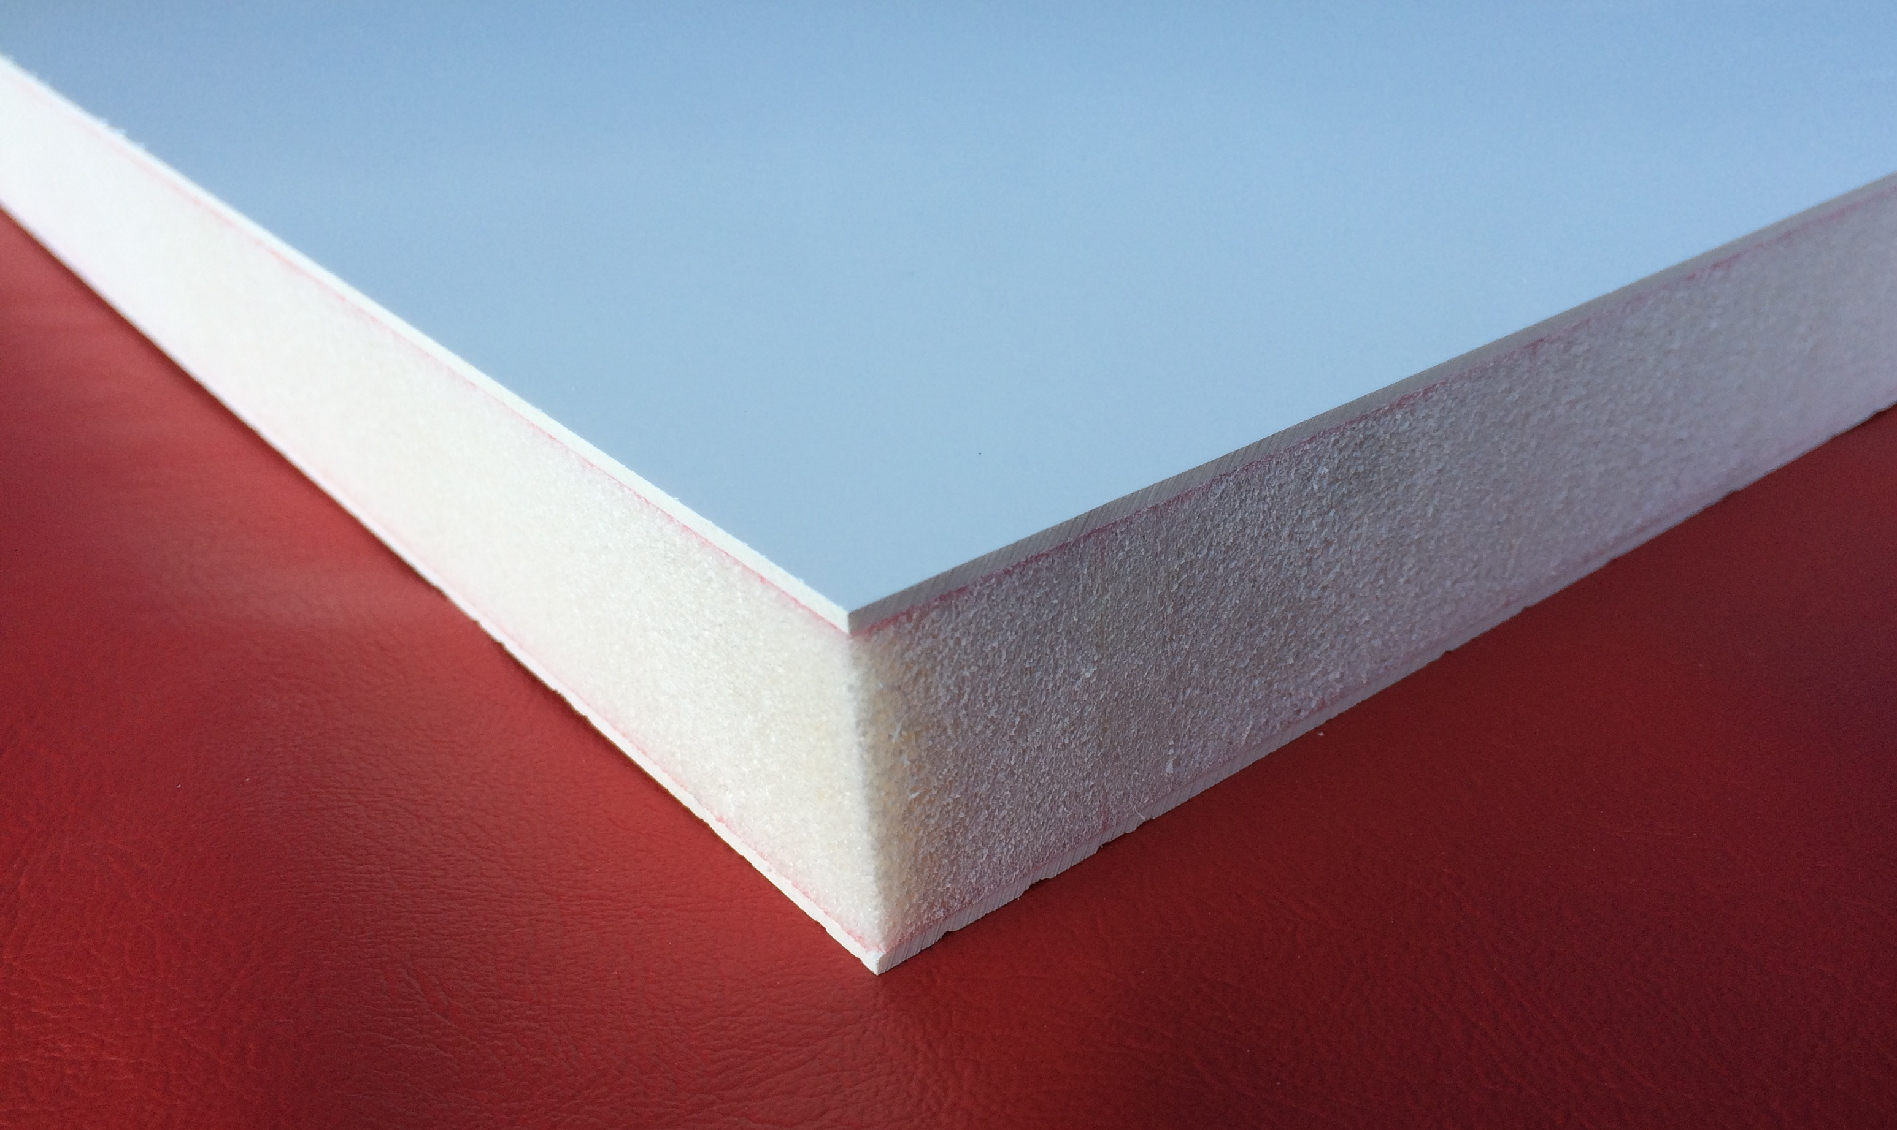
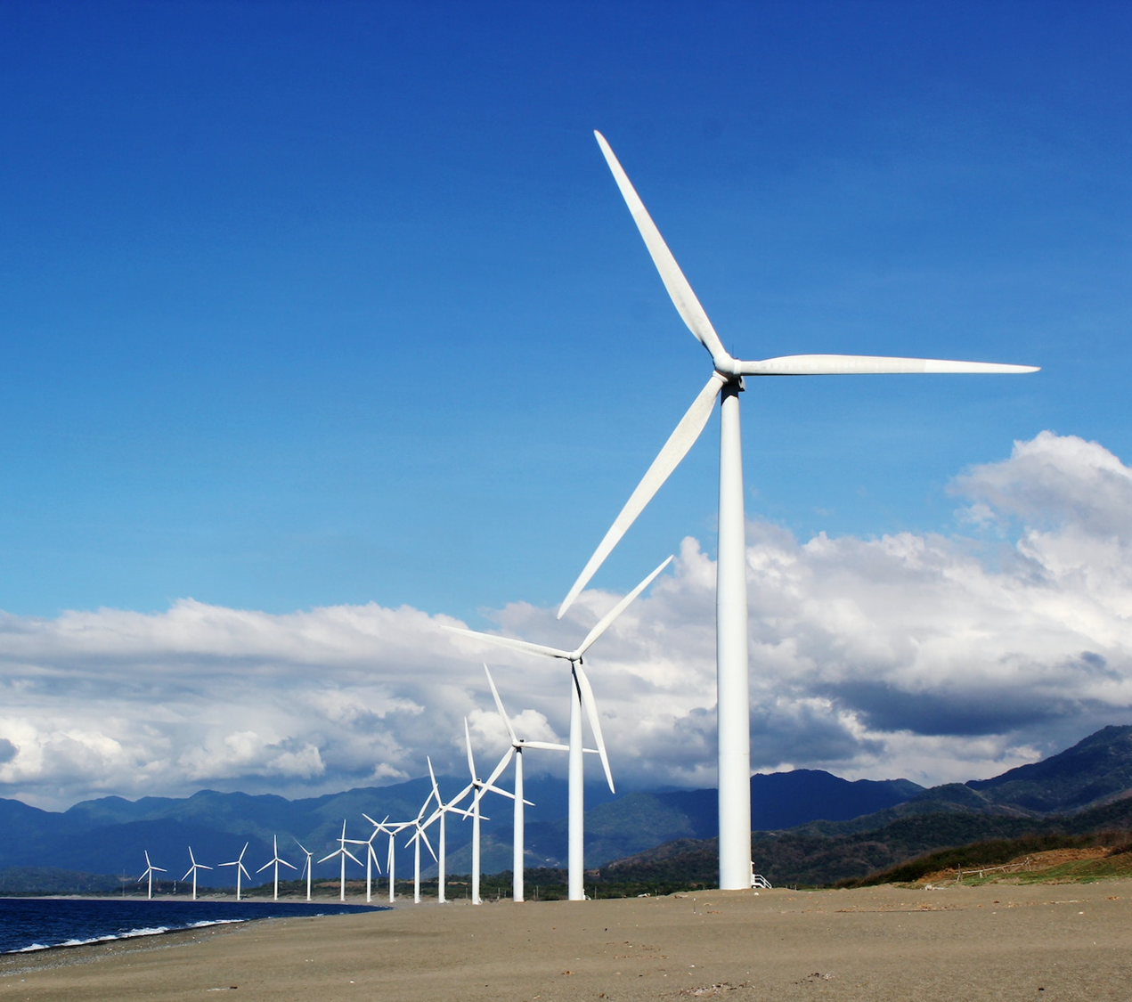
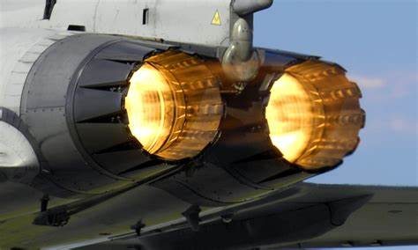
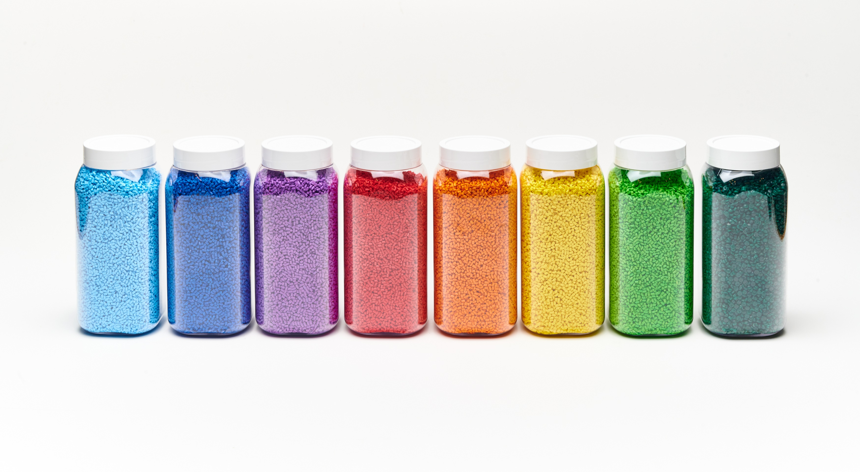
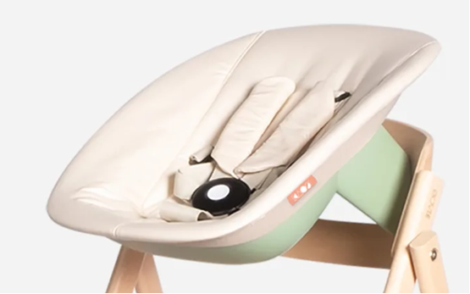
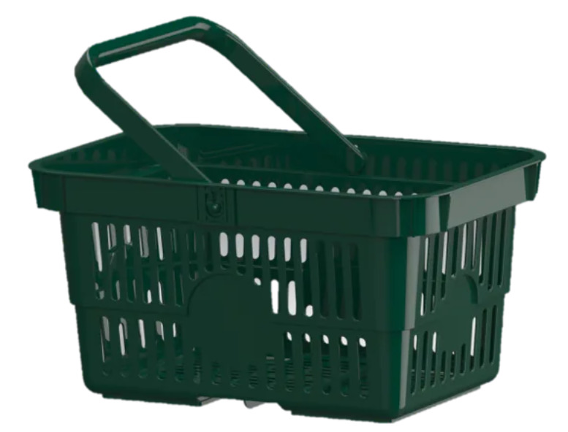
Sharpened commercial strategy
Light Weighting
- Develop strong position in PET foam additives through R&D
High Temperature
- Drive composites and coatings that endure higher temperatures
Aesthetics
- Deliver unique solutions for recycled, biobased and virgin plastics
Recycling
- Leverage development process and turn first successes into business
Notes:
Since I joined as CEO, we have clearly sharpened our commercial strategy, involving all facets, business units and key stakeholders in our business.
The same basic ideas under "reactive chemistry that is added to plastics" ends up in very wide application areas. So the specialized and leading core knowledge of Nexam results in additives used in quite different end markets.
We have sliced, diced and really dissected the way we approach the market in various segments and verticals, the value we can deliver to customers and end customers and have ended up in a new way of structuring and segmenting our business. Going forward, expect to see us gradually moving towards reporting and driving our business more according to these four pillars:
Light weighting: in many ways our core commercial business, with PET foam as the main driver. Our strategy in this segment is to drive and develop the PET foam market, not only in our main focus area of wind power, but also beyond – together with existing customers as well as new
High Temperature: another key focus area for Nexam during several years, where our strategy going forward is to leverage our current position in what we typically refer to as advanced plastics and composites for applications in very high temperatures.
Aesthetics: a new way of characterizing what we deliver in our existing business "Performance Masterbatch", where we have made an in-depth analysis of what we as a company can deliver, where we fit in the value chain and how we can, in a more strategic way, build on our market presence in both the Nordics and Eastern Europe. We have, among other things, identified numerous very obvious synergies with other parts of our business – not least our fourth and last pillar: Recycling
Recycling, our fourth pillar, is perhaps the segment with the most mind-boggling future potential. During the summer, we have announced two new patents, covering around 50% of all virgin plastics and the market response has been tremendous. Our strategy within recycling is to approach it in the same way we have built traction in other segments, such as PET foam, where we gradually move from research and patents over into small pilot projects together with customers, validate technology and industrialization and move over into commercial scale orders and ongoing business.
These four areas build on similar core competences and reactive chemical solutions, all have in common that performance enhancement by additives is a key to our customers market success.

Slide 6
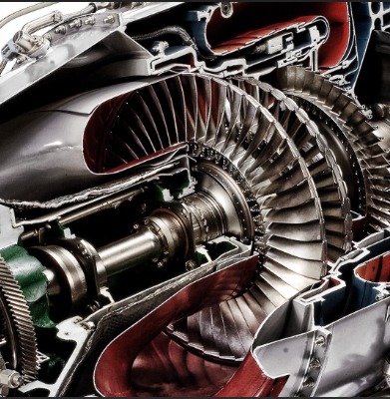
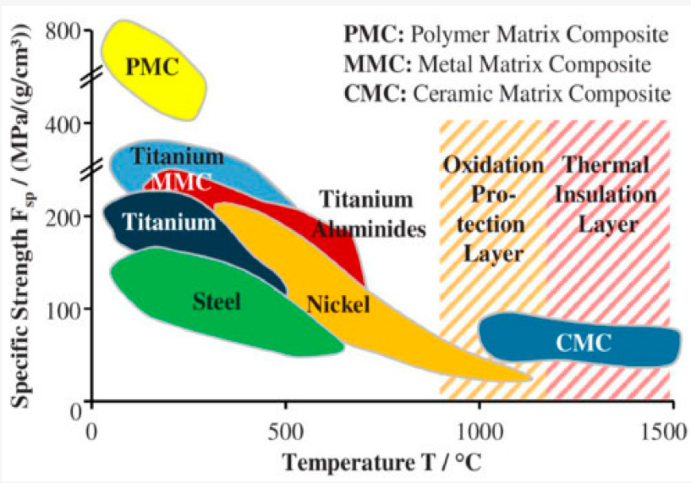
Extremely heat-resistant composites
Composites containing Nezam’s additives (>400 C)
Notes:
•Nexam's additives make Polyimide composites more temperature resistant (400° C), far beyond other polymers
•Polyimide composites can replace metal components in advanced alloys, such as titanium alloys or Inconel, to decrease weight and
reduce need for heavy insulation blankets
•The continued weight reduction in jet engines is an important part of further reduced fuel consumption.
•A rule-of-thumb is that a reduction in fuel consumption of about 0.75% results from
each 1% reduction in weight in jet engines
In addition to the currently dominating military applications, we participate in the development of the use in civilian jet engines

Slide 7
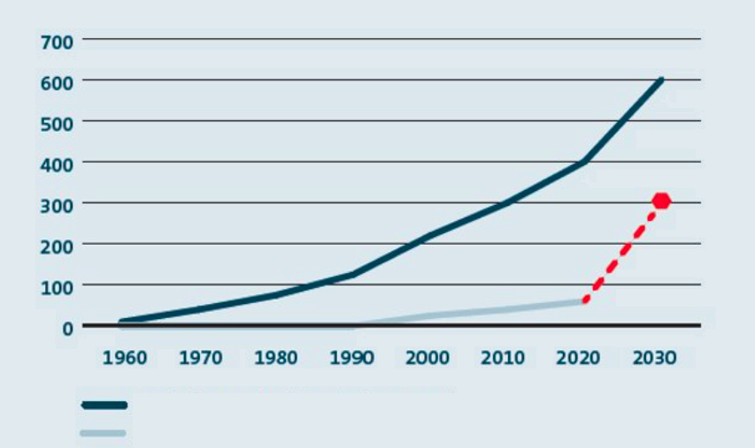
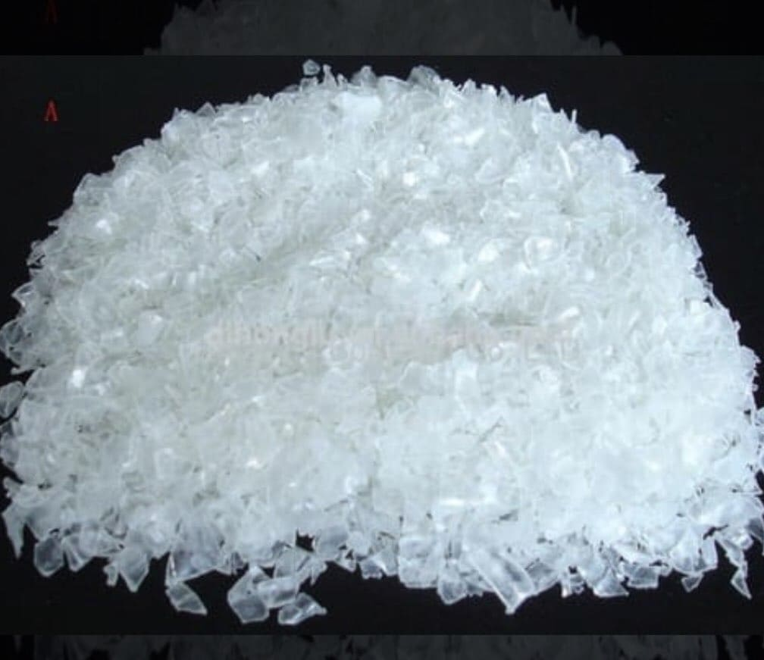
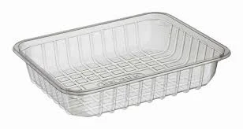
Recycling predicted to grow substantially
Portfolio of tailored additives to suit a broad range of applications
Improves the business cases for our customers, key to secure business
Enable customers to use recycled plastics in more advanced applications, or lower grade recycled materials for decreased cost
Total plastics usage (million tons)
Total recycled plastics (million tons)
Source: OECD and EU targets for plastics recycling
Notes:
Our fourth and last segment, Recycling, is – like I said in the beginning of this presentation – perhaps the most promising one, where the business potential on a global level is truly mind-boggling. Our "Reactive Recycling" concept allows what we call "upcycling", meaning that recycled plastics can be upgraded to create better end products than would otherwise be possible.
Our recently announced patents for high volume materials such as PE, PP and PET, covering 50% of all virgin plastics, have generated a tremendous interest, from potential customers across the globe.
Our strategy within recycling in many ways mimics the way we have built traction and commercial success within e.g PET foam, meaning a focus on application development and verification, finalizing projects together with customers, and gradually turning them into a strong growing business. When the technology is proven at industrial scale, we copy those successes and scale!
Our first commercial gains within recycling have thus far been within technical fibres, plastic sheets for packaging, moulded containers and agricultural films. With our unique, patented technologies, Nexam has all the prerequisites to develop into a both necessary and strong partner within both upcycling and the whole recycling supply chain. Recycling, in many ways, is a truly global business, where the adressable market is more or less unlimited. Compared to e.g PET foam, where the number of key global players count in single digits, the same within recycling is anywhere from 100X to 1000X
Going forward, this will obviously require us to adapt, both as an organization, with our partner structure and in terms of supply chain, but I reiterate that the opportunities presented within this segment can multiply Nexam's business many times over.

Slide 8
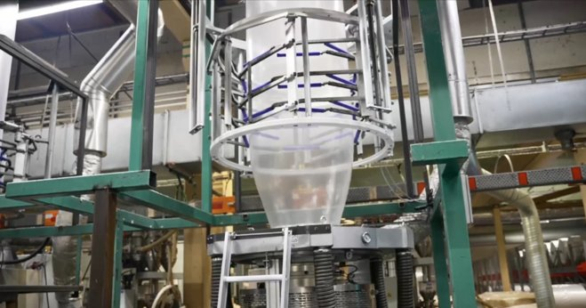
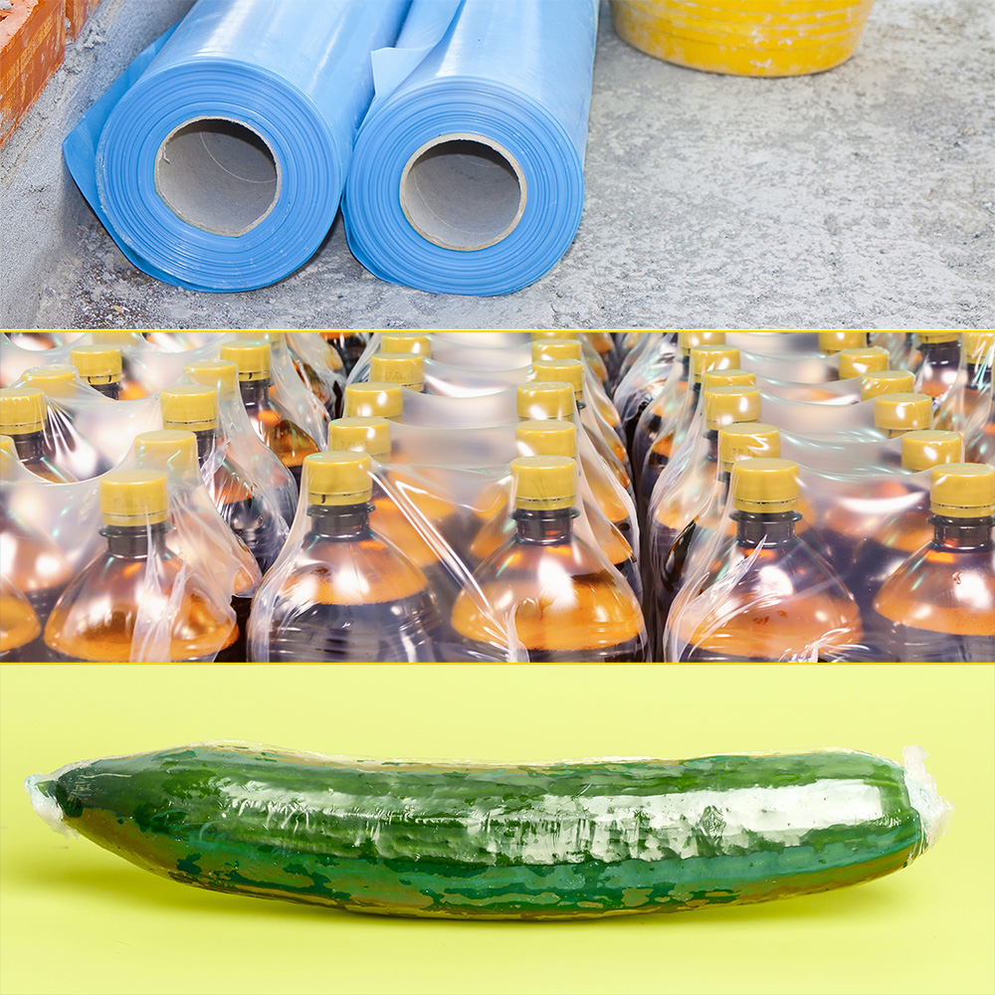
Industrial scale rollout with Kullaplast
Collaboration with local Skåne company Kullaplast, leading packaging materials’ producer
Addition of Nexam’s R305 additive enables Kullaplast to introduce a significantly higher share of recycled materials (PCR) than previously
Quality and performance of the end product remains intact, while improving environmental performance – and production cost
The collaboration has attracted significant international interest, given the implications for a very large and growing product segment, estimated to be worth 8-10 billion USD globally
Market potential
Packaging film market:
- Value: 8-10 billion USD
- Volume: 4-5 million tons
- CAGR: 5-7%
Est. share recycled: 10%
Potential value additives:
- 28-35 million USD
Notes:
One thing to emphasize is that that recycling platics is not only good for the enviroment, it can also be good business.
Recycled PET is avaiable on the market but high-quality grades can be rather expensive. This is due to present and future legisaltion about recycled content, but also voluntary committements by companies to use recycled materials.
Now, assume that you replace a part of the expensive r-PET with a cheaper but lower quality r-PET. This will of course reduce cost but also influnce the quality. Using Nexams additive you can boost the quality and get a similar performance.
If you do the cost analysis of this using realistics number you see that the additional cost around 6%, but the increase in value of the materials is around 22%. This shows that it can be good business to upgrade recycled polymers.

Slide 9
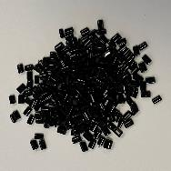
Clear customer value proposition
EXPENSIVE
Reduce total cost using Nexam Additive
Reduced raw material cost* -30%
Additional cost (Nexam Additive)* +6%
Reduced cost final product* -25%
CHEAP
r-PET
30% Expensive Grade
60% Cheap Grades
10% Virgin
r-PET
80% Expensive Grade
10% Cheap Grades
10% Virgin
* Indicative numbers, based on customer cases
Notes:
One thing to emphasize is that that recycling platics is not only good for the enviroment, it can also be good business.
Recycled PET is avaiable on the market but high-quality grades can be rather expensive. This is due to present and future legisaltion about recycled content, but also voluntary committements by companies to use recycled materials.
Now, assume that you replace a part of the expensive r-PET with a cheaper but lower quality r-PET. This will of course reduce cost but also influnce the quality. Using Nexams additive you can boost the quality and get a similar performance.
If you do the cost analysis of this using realistics number you see that the additional cost around 6%, but the increase in value of the materials is around 22%. This shows that it can be good business to upgrade recycled polymers.

Slide 10
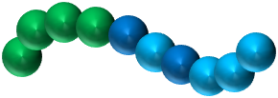
Scientifically validated
Multiple extrusion cycles to simulate recycling process
Polymer highly degraded
after 9 cycles!
VISCOSITY
→ 9th cycle back to 4th cycle!
PROCESSING CYCLES
Bernagozzi et al, Polymer Degradation and Stability, Volume 223, May 2024, 110714
Notes:
So how does this work in practise?
Let me show you some experimental data from a research group in Torino. They took a fresh polymer and extruded it multiple times, in order to simulate what happens during recycling. They observed that the viscosity of the polymer continously decrease. This is due to that the polymer chains breaks and after nine cycles the polymer is highly degraded and it is difficult to use this material in any application.
However, if you take this material that has been cycled 9 times and use our additive, you see that the viscosity increase. The viscosity actually goes back up to the level corresponding to cycle #4! This means that we are rebuilding molecular weight and we are reparing the polymer chains, at least to some extent. This show the great benefit of using Rective Recyling. For our customer this means a material that can be used in more advanced applications and hence has a higher value.

Slide 11
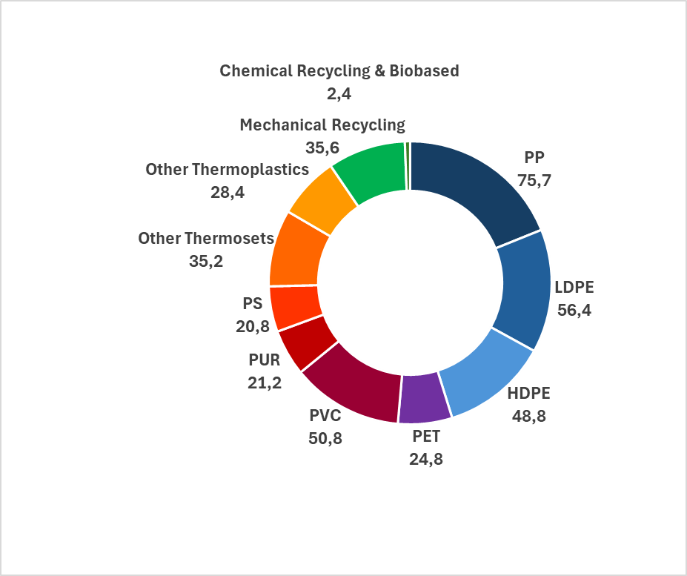
Global Plastic Production
RECYCLED & BIO
400 Mt
(2022)
FOSSIL-BASED
Source: plasticseurope.org
Notes:
So what does the plastics market look like today?
The global production of plastics is today over 400 Million Tones per year and still growing. However, the fraction of recycled or bio-based is still very small, only about 10% on a global scales. What we need to do is to go from fossil-based to recycled or bio, that is from ”blue” to ”green”. Please also note that the ”blue” we produced today is the material we should recycle tomorrow.
Now, imagine the growth potential for companies that want to be part of this transition from blue to green and has technology to that can accelerate it!

Slide 12
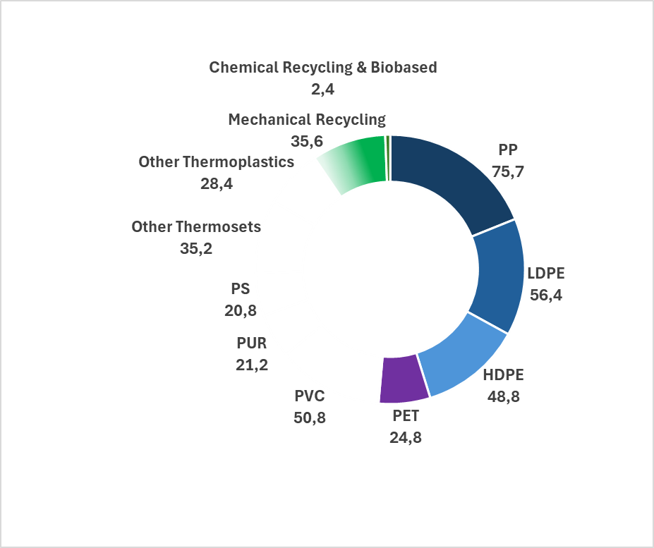
Global Plastic Production
>200 Mt
POLYOELFINS
Solutions and patents for Polyolefins & PET →
up to 50% of the global production of plastics!
Source: plasticseurope.org
Notes:
Today, Nexam have commerical solutions that can be used for reycled PET and recycled polyolefins. These classes of polymer constitutes about 200 Million tonnes of the global production of plastics , that is more than 50% of the worlds production. Hence there is huge potential market for Nexams products.

Slide 13
ATH Sales of Recycling in Q1
Q1 2025 Sales 3.6 mSEK (1.3 mSEK), corresponding to 50% QoQ growth!
New major customer ramping up full scale production – Q2 outlook positive

Slide 14
Q1 2025 - Business Update
Financial Highlights (Q1)
Net Sales: 49.3 mSEK (53.2 mSEK); impacted by continued very low call-offs from some major customers
Gross Margin: Increased to 48% (45%)
EBITDA: 1.3 mSEK (2.2 mSEK)
Financial stability achieved, funded by self-generated cash flows; 25 mSEK credit facility unused
Increasing Market Activities (during and after quarter end)
Collaboration with Kullaplast on blown film attracted substantial international interest
Continued very strong inflow of new potential customers, especially within Recycling
Hired five (5) new machine operators to the Lomma plant, to handle increasing volumes
Successful participation at PRSE in Amsterdam (April), preparing for Plastteknik (SE) and Mumbai recycling fair
Credit facility increased to 25 MSEK, with support from EKN (Swedish Export Credit Agency)
Successful completion of the TAPE-X (TAPE Extreme) project, funded by Innovate UK

Slide 15
Q1 2025 - Financial update
 | 2025 | 2024 | 2024 | 2024 | 2024 | 2023 | 2023 | 2023
kSEK | Q1 | Q4 | Q3 | Q2 | Q1 | Q4 | Q3 | Q2
Net sales | 49 281 | 48 640 | 44 092 | 53 626 | 53 219 | 50 461 | 45 834 | 41 623
Operating expenses | -22 347 | -21 191 | -18 066 | -22 538 | -21 418 | -20 978 | -18 931 | -26 215
EBITDA* | 1 299 | 2 039 | 1 189 | 2 622 | 2 212 | 1 611 | 711 | -8 298
Cash and bank | 1 095 | 2 882 | 8 592 | 10 988 | 9 909 | 9 056 | 16 304 | 20 424
Cash flow from operations | 1 876 | -1 563 | 899 | 4 469 | 3 622 | -4 510 | 25 | -6 564
Average number of employees | 53 | 53 | 53 | 53 | 54 | 53 | 54 | 55
Sales Performance Masterbatch | 28 846 | 26 244 | 24 738 | 31 128 | 27 525 | 25 760 | 23 461 | 26 166
Sales Performance Chemical | 20 435 | 22 396 | 19 354 | 22 498 | 25 694 | 24 700 | 22 374 | 15 456
 |  |  |  | 2024 | 2023 | 2022 | 2021 | 2020
kSEK |  |  |  | FY | FY | FY | FY | FY
Net sales |  |  |  | 199 577 | 190 152 | 221 756 | 219 452 | 165 830
Operating expenses |  |  |  | -83 212 | -88 100 | -87 465 | -78 612 | -64 519
Adjusted EBITDA* |  |  |  | 8 061 | -3 054 | 8 061 | 7 605 | 6 324
EBITDA* |  |  |  | 8 061 | -5 856 | 112 | 6 297 | 4 908
Cash and bank |  |  |  | 2 882 | 9 056 | 22 875 | 63 601 | 29 791
Cash flow from operations |  |  |  | 7 426 | -352 | -11 100 | 7 255 | -17 084
Average number of employees |  |  |  | 53 | 55 | 54 | 49 | 44
*EBITDA är resultat före avskrivningar, ränta och skatt
Financial comments for the quarter
Net sales in Q1 amounted to MSEK 49.2 compared to MSEK 53.2 in Q1 2024.
Margin in Q1 was 48% compared to 45% in Q1 2024.
EBITDA amounted to +1.3 (+2.2) MSEK in the quarter.
Cash flow from operations amounted to MSEK +1.9 (+3.6) MSEK.
Cash and bank balance at the end of the quarter amounted to 26.1 mSEK including a credit facility of MSEK 25.
13

Slide 16
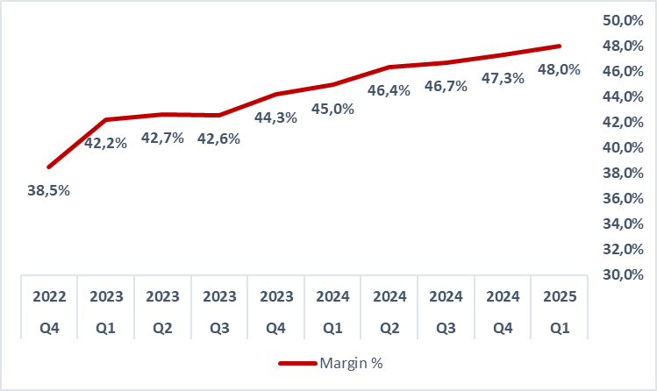
Improved margin nine quarters in a row

Slide 17
Resilient business prepared for growth
3 recurring
customers
9 recurring
customers

Slide 18
Significant increase in Recycling activity

Slide 19
Scalability
Reduced break-even (EBITDA) from ~55 to ~ 45 MSEK per quarter
Beyond break-even point, top line increase contributes ~35% to bottom line
Past year has shown organization’s ability to generate incremental sales and new business
>90% of sales are recurring to serial production, to an increasing customer base
Potential to double volume with current organization and cost base – no additional investments needed, nor significant increase in overhead costs
The contribution margin is expected to remain at this level the coming quarters
Notes:
During Q4 we continued to see sequential growth compared to Q3 and Q2, although sales are still not in line with previous year – primarily due to slow industrial activity. Compared to last year, sales were 9% lower, but compared to Q3 sales were 10% higher.
Gross margin was significantly improved, from 39% same period last year to 45%. Margin also improved somewhat compared to Q3.
EBITDA was well above the same period last year, despite lower sales volumes, as a result of both the margin improvement and the ongoing cost savings programmes.
The first cost savings programmes of 13 MSEK have now been fully executed and implemented. As previously announced,it will reach full effect in Q1 2024.
As mentioned, I will go through key financials from Q4, and a comparison with the same quarter previoius years.
Mer från Marcus

Slide 20
Project pipeline overview
Same standardized, and well proven, project pipeline process also for Recycling (with 3-10X more volume)
Recycling High Temp Lightweight
Customer interest / early stage
Evaluation stage
Typically Non-disclosed
>100 10 15-20
Development stage
Proof-of-concept stage
Scale-up/industrialization
~15 ~5 ~7
Launch
Commercial
Potential PM’s
~8 ~2 ~2
Toll gates
Notes:
Light weighting almost cut in half since 2022, but with five more or less active customers (vs. 2 in 2022)
Strong performance in Masterbatch, especially Eastern Europe
Reactive recycling 200% increase since 2023, although from low levels
ReColour Plus numbers included in MB (primarily Nordics), meaning total “Recycling” is higher than indicated here

Slide 21
Three underlying business logics
Recycling (7%):
”The scale-up"
7%
Light Weight & High
Temperature (34%):
”The growth engine”
41%
Aesthetics (59%):
”The base business”
55%

Slide 22
Three underlying business logics
Recycling (4%):
Start-up within the company, now scaling up, leveraging Nexam’s
additive expertise and with solid IP portfolio (~50% of plastics)
Proven product market fit and ~100% sustainable growth achievable
Self-funded, peers include Waste Plastic Upcycling, Pryme, Loop
Industries, Carbios, SES.
7%
High Temperature & Light Weight (41%):
Expertise in tailor made additives and long-term customer relationships
Transition to partly customer-funded R&D, with strong patent/IP portfolio
Historically >20% growth, with peers like EMS Chemie and Polygiene
41%
Aesthetics (55%):
Local plastics industry focus with strong personal relationships
Shifting to recycled raw materials, offering differentiation and solid margins
Peers: local masterbatch players
55%

Slide 23
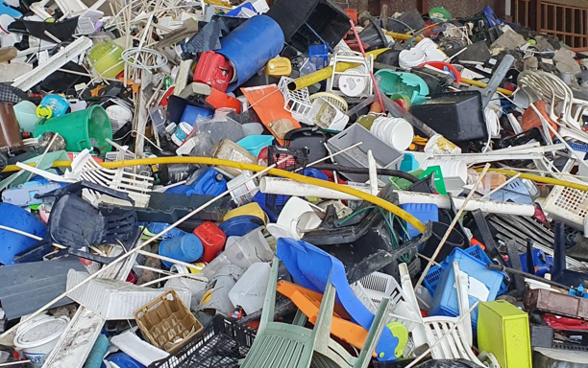
Positive turnaround - strong 2025 outlook
Returning to growth in key segments, with increasing profitability and a broader customer base
Past cost savings program enables profitable growth and balanced cash flow.
Focused commercial strategy and recycling innovation driving market differentiation
Expanding position in PET foam, despite headwinds
Several long term opportunities in the high temperature segment
Recycling breakthroughs: multiple customers transitioning from testing to industrial production
Notes:
Thank you, Marcus.
To wrap up the presentation, I would like to give you a bit of business outlook for 2024. In summary, I think it's fair to say that the wind really has turned, both for Nexam and for our biggest current business, wind energy. We are still in a slow market, but thanks to a very active market approach, we see a positive outlook for 2024. Compared to both 2021 and 2022, when sales were in line with today, our commercial activity level, cooperation with customers and the number of active deals are significantly better and higher today.
As already noted, our cost savings program, delivering a total of 13 MSEK annual savings creates the foundation for a return to a profitable growth trajectory. Our new sharpened commercial strategy helps us focus our internal resources in a much better way, with a more customer – and customer needs – focused approach. Looking at each of our four segments:
Light weighting, especially wind energy and PET foam, shows clear positive indications of market recovery. While too early to deliver new revised financial targets, as the underlying markets are still volatile, we do see a positive situtation with both existing and new customers
Within High temperature, we expect continued growth, as we can see that our stamina over the years is starting to pay off in several projects and increased order volumes, such as the 22 MSEK repeat order from one of our US High temperature customers. Our strong position also, as mentioned, enables us to move to an increased R&D cost coverage, meaning that High temperature will deliver even stronger total margin contribution over time
Our "new" segment Aesthetics is an area where we have an opportunity to really set us apart from competition, both in terms of product innovation but not least our focus on recycling. We see opportunity to counter the general slump in industry activity by adding to our product offering, and helping our customers deliver more value in the next stage. We are currently launching our "ReColour Plus" offering, allowing our customers to deliver unique and attractive end products from hard to recycle plastics.
Recycling, while not yet a significant part of our sales, has seen the first commercial breakthroughs within Reactive Recycling, and initial business growth is within reach. We expect to see solid commercial traction within Recycling over the course of the 2024, with potential for exponential growth on the horizon
https://www.pexels.com/photo/sunset-clouds-motion-mill-6493719/

Slide 24
Why invest in Nexam Chemical?
Strong Growth Potential
Focused Commercial Strategy, in line with Key Global Trends
Huge untapped potential in Recycling
Enhanced Innovation Capacity and Diverse Portfolio of Patented Solutions
Improving Profitability and solid Financial Position
Scalable Organization
Strategic M&A Opportunities
Notes:
I believe Nexam offers global cleantech potential at basic industry valuation
ØBroad portfolio of cleantech solutions within four clear market segments, each with strong underlying growth
ØSubstantial growth potential (20% CAGR target) driven by clear customer offerings and solid business cases
ØPatented cleantech solutions to several large societal challenges, driven by megatrends within sustainabilty
ØEnabling increased recycling of plastics, especially packaging, in line with global targets
ØSupporting sustainable growth of wind power production, both new installations and replacement
ØMajor investments done within production capacity, enabling >100% volume increase with no Capex
ØIn-sourcing of production drives gross margin (>45% within reach), maintaining third party production for flexibility
ØCost savings programmes implemented, giving a lower break-even point and positive cashflow
ØPotential to deliver positive EBITDA already from quarterly revenue levels of 60 MSEK (within reach already this year)
ØWell honed organization with potential to take on much bigger tasks as they emerge
ØStronger than ever bandwidth for innovation, and maintained know-how, despite cost savings programmes
ØCommercial team focused around a sharpened strategy, targeting four key segments with global scope
ØBusiness model with potential for targeted M&A, especially to grow geographical footprint

Slide 25
Why invest in Nexam Chemical?
Very high ambition and plans for 2025 and later regarding all financial KPIs
Funding operations and growth with own cash flow, and unutilized credit facility
Eight consequtive quarters of improving margins, expect at least this level coming quarters
Growing portfolio of patented cleantech solutions driven by megatrends within sustainability
Substantial growth potential driven by clear customer offerings and solid business cases
Major investments done within production capacity, enabling +100% volume with no Capex
Experienced management team, with track record of driving growth
Business model with potential for targeted future investments / M&A
Potential within recycling on par with highly valued start-ups
Notes:
I believe Nexam offers global cleantech potential at basic industry valuation
ØBroad portfolio of cleantech solutions within four clear market segments, each with strong underlying growth
ØSubstantial growth potential (20% CAGR target) driven by clear customer offerings and solid business cases
ØPatented cleantech solutions to several large societal challenges, driven by megatrends within sustainabilty
ØEnabling increased recycling of plastics, especially packaging, in line with global targets
ØSupporting sustainable growth of wind power production, both new installations and replacement
ØMajor investments done within production capacity, enabling >100% volume increase with no Capex
ØIn-sourcing of production drives gross margin (>45% within reach), maintaining third party production for flexibility
ØCost savings programmes implemented, giving a lower break-even point and positive cashflow
ØPotential to deliver positive EBITDA already from quarterly revenue levels of 60 MSEK (within reach already this year)
ØWell honed organization with potential to take on much bigger tasks as they emerge
ØStronger than ever bandwidth for innovation, and maintained know-how, despite cost savings programmes
ØCommercial team focused around a sharpened strategy, targeting four key segments with global scope
ØBusiness model with potential for targeted M&A, especially to grow geographical footprint

Slide 26
The future of plastics. Patented.
Notes:
I hope I have been able to give you a glimpse of our world. A world where we see what the future of plastics can look like. A future that we hold a lot of the keys to. Keys in the form of patents.
Q4 really saw the wind turning, and we have a positive outlook for 2024 combined with endless possbilities to grow our business on long term.
With that, I would like to open up for a Q&A session.
P/C: https://www.pexels.com/photo/white-wind-turbines-on-gray-sand-near-body-of-water-3976320/

Slide 27
Q&A
Notes:
With that, we will go over to an interactive Q&A session, where we hope to be able to answer any questions you may have, pertaining to this presentation, our new commercial strategy and our cost savings programme.

Slide 28
Download our 2024 Annual Report

Slide 29
Ronnie Törnqvist, CEO
+46 706 254 185
ronnie.tornqvist@nexamchemical.com
NEXAM CHEMICAL
Industrigatan 27, 234 35 Lomma
www.nexamchemical.com
CONTACT:

